Slide 1
CALERIE™: Two Years of Calorie Restriction in Humans: Effects on Lifespan and Healthspan Biomarkers
The CALERIE Study Group
CALERIE was and is supported by the following grants from the National Institute
on Aging: U01AG022132, U01AG020478, U01AG020487, U01AG020480, and U24AG047121
.

Slide 2
CALERIE Conceptual Model
Chronic Caloric
Restriction
?
?
Healthspan
Lifespan
Healthspan—mean time to disease
Lifespan—mean time to death, irrespective of disease

Slide 3
Medium-term CR (Two Years)
Walford RL, Harris SB, Gunion MW. The calorically restricted low-fat nutrient-dense diet in Biosphere 2 significantly lowers blood glucose, total leukocyte count, cholesterol, and blood pressure in humans. Proc Nat Acad Sci. 1992;89:11533-11537.
Verdery RB, Walford RL. Changes in plasma lipids and lipoproteins in humans during a 2-year period of dietary restriction in Biosphere 2. Arch Intern Med. 1998;158(8):900-906.
Walford RL, Mock D, MacCullum T, Laseter JL. Physiologic changes in humans subjected to severe, selective calorie restriction for two years in biosphere 2: health, aging and toxicological perspectives. Toxicolog Sci 52 (Suppl.): 61-65, 1999.
Sample size of 8 (4 each men and women, longitudinal design, no randomization; have cessation follow-up data).

Slide 4
Long-term CR (Years)
Fontana L, Meyer TE, Klein S, Holloszy JO. Long-term calorie restriction is highly effective in reducing the risk for atherosclerosis in humans. Proc Nat Acad Sci. 2004;101:6659-6663.
Meyer TE, Kovacs SJ, Ehsani AA, Klein S, Holloszy JO, Fontana L. Long-term caloric restriction ameliorates the decline in diastolic function in humans. J Am Coll Cardiol. 2006;47:398-402.
Fontana L, Klein S, Holloszy JO. Effects of long-term calorie restriction and endurance exercise on glucose tolerance, insulin action and adipokine production. AGE 32:97-108, 2010.
Case-control cross sectional study, 28 individuals per group, matched for age, sex, height (body fat for exercisers)

Slide 5
Effects of Long-term CR on CV Risk Factors
Variable Baseline CR
BMI (kg/m²) 24.5 ± 2.6 19.5 ± 2.1
Total cholesterol (mg/dL) 194 ± 45 157 ± 38
LDL-C (mg/dL) 122 ± 36 86 ± 17
Triglycerides (mg/dL) 149 ± 87 54 ± 15
Systolic BP (mmHg) 132 ± 15 97 ± 8
Diastolic BP (mmHg) 80 ± 11 59 ± 5
Data are mean ± SD from 12 middle-aged subjects before and after 3-15 years of caloric restriction (CR).
Adapted from Fontana, et al. PNAS, 2004.

Slide 6
Short-term CR (Up to One Year) -2-
Larson-Meyer, Heilbronn LK, Redman LM, et al. Effect of calorie restriction with or without exercise on insulin sensitivity, β-cell function, fat cell size, and ectopic lipid in overweight subjects. Diabetes Care 29: 1337-1344, 2006.
Heilbronn LK, De Jong L, Frisard, MI. Effect of 6-month calorie restriction on biomarkers of longevity, metabolic adaptation, and oxidative stress in overweight individuals: a randomized controlled trial. JAMA 295: 1539-1548, 2006.
Fontana L, Villareal DT, Weiss EP, et al. Calorie restriction or exercise: effects on coronary heart disease risk factors. A randomized, controlled trial. Am J Physiol. Endocrin Metab. Jul 2007;293(1):E197-202.
Lefevre M, Redman LM, Heilbronn LK, et al. Caloric restriction alone and with exercise improves CVD risk in healthy non-obese individuals. Atherosclerosis 2009;203:206-13.
Phase 1 CALERIE: Groups of 11/12, (BMI 25-29.9), 6-month CR or 18/10, (BMI 23.5-29.9), 12 months CR

Slide 7
Specific Questions Being Addressed / Hypotheses of Interest
Time course effects of CR on cardiometabolic risk factors (i.e., BP, cholesterol, glucose control, Insulin sensitivity) by group — healthspan.
  Difference between the weight loss phase (first 12 months) and the weight maintenance (metabolic adaptation) phase (12- to 24-months) despite the same degree of CR.
Time course effects of CR on biological markers of aging — lifespan.
  Metabolic adaptation, thyroid hormone tone, inflammation
Safety
Differences by weight loss strata and sex.
Study: 220 individuals, randomized to CR:AL in 2:1 ratio , young, recruited in two BMI strata of 22-24.9 and 25-27.9, followed for two years—198 finished study.

Slide 8

ACKNOWLEDGEMENTS
On behalf of the CALERIE Study Group
DCRI
William E. Kraus
Manju Bhapkar
James Rochon
Carl F. Pieper
PBRC
Corby Martin
Leanne Redman
Don Williamson
Eric Ravussin, PI
Washington U
Luigi Fontana
Samuel Klein
Dennis Villareal
John O. Holloszy, PI
U01AG022132 U01AG020478 U01AG020487 U01AG020480
TUFTS
Sai Das
Tammy Scott
Ed Saltzman
Susan Roberts, PI
NIA
Sergei Romashkan
Evan Hadley

Slide 9
Longitudinal EI and % Weight Loss
Energy Intake (kcal/d)
 | AL (n=75) | CR (n=143) | p
Baseline | 2422 (50) | 2409 (38) | .88
BL-M12 | -22 (25) | -341 (19) | <.0001
BL-M24 | -14 (23) | -258 (18) | <.0001
M12-M24 | -8 (11) | -83 (18) | <.0001
Weight Maintenance Phase
% Weight Loss: BL-M24
 | AL | CR
≥5% | 18 | 91
≥10% | 3 | 56
≥15% | - | 14

Slide 13
Metabolic Syndrome Score
BMI x Group Interactions
High BMI
Low BMI
Significant, but due entirely to effects in AL Group => differential behavior by BMI strata?

Slide 14
Conclusions
Significant CR effect, despite normal body mass, on:
  Systolic and diastolic BP
  LDL-C, HDL-C, and TG
  Fasting insulin, HOMA, AUC insulin, insulin sensitivity, and insulin response (not on glucose measures).
  Metabolic syndrome score (via BP, HDL-C, TG and WC)
No significant CR effect on:
  glucose measures (FBG, AUC glucose, etc.)
  IL6, TNF-α, norepinephrine
BMI x Group interactions due to AL group effects

Slide 15
Conclusions -2-
In general, maintenance of effects, during “weight maintenance” phase, on:
  Systolic and diastolic BP
  LDL-C and TG
  Fasting insulin, HOMA, AUC insulin, insulin sensitivity.
  Metabolic syndrome score (via BP, HDL-C, TG and WC)
Enhanced effect during “weight maintenance phase” on:
  HDL
  insulin response
  hsCRP

Slide 21
CALERIE Conceptual Model
Chronic Caloric
Restriction
Healthspan
Yes!
Yes!
Lifespan
Healthspan—mean time to disease
Lifespan—mean time to death, irrespective of disease

Slide 22
Questions ???

Slide 23
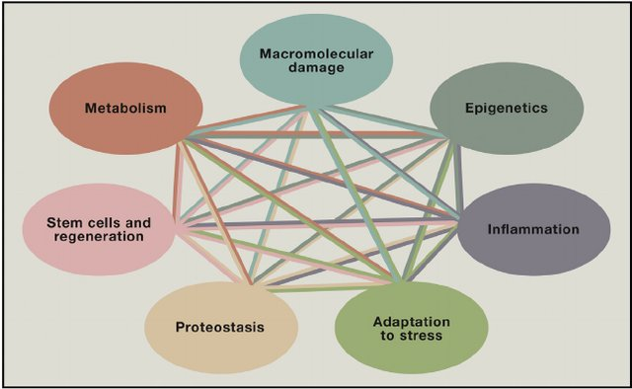
The Pillars of Aging

